Slide 1





Predictive Analytics of Climate Stress Impact on the Italian Mediterranean Buffalo
Presented by
Mohammad Sheikh
Supervisors
Dr. Luca Barbierato
Dr. Matteo Santinello
November 2025
Predictive Analytics of Climate Stress Impact on the Italian Mediterranean Buffalo

Slide 2
Heat Stress
milk production
feed intake
performance.
Diseases
Sweating
Blood flow to skin
heart and respiration rate [1]
1] - Bernabucci, U.; Lacetera, N.; Baumgard, L.H.; Rhoads, R.P.; Ronchi, B.; Nardone, A. Metabolic and Hormonal Acclimation to Heat Stress in Domesticated Ruminants. Animal 2010, 4, 1167–1183. [Ref]
[
Predictive Analytics of Climate Stress Impact on the Italian Mediterranean Buffalo

Slide 3
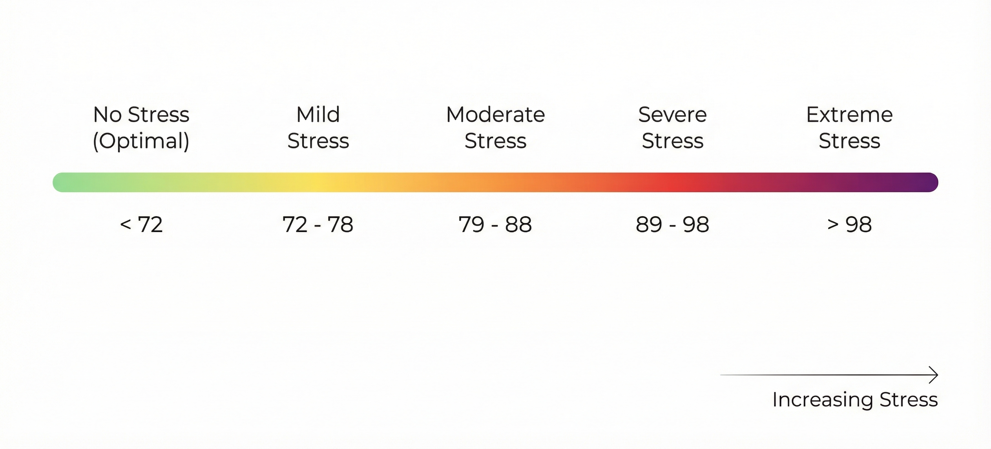
THI ranges were reported by Dash et al. [2]:
Predictive Analytics of Climate Stress Impact on the Italian Mediterranean Buffalo

Slide 4
Studies on Milk Prediction
Effect of HS on cow milk yield ,by Hassan, 2025
individual models for predicting cow milk production in Korea, by Song,2025
predict the next month's daily cow milk yield in Australia by Ji,2022
predict SCC in the Italian Mediterranean Buffaloes by Bobbo, 2022
Predictive Analytics of Climate Stress Impact on the Italian Mediterranean Buffalo

Slide 5

Hierarchy in time series (HTS)
Time series data can be naturally hierarchical.
Data can be aggregated or disaggregated based on:
Types
Features
geographic division. [4]
Predictive Analytics of Climate Stress Impact on the Italian Mediterranean Buffalo

Slide 6
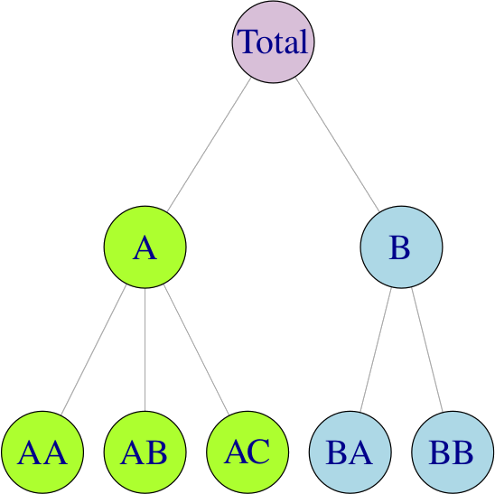
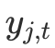
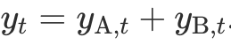
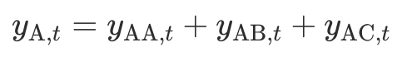
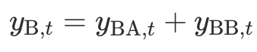
Hierarchy in time series (HTS)
The value of parent is always equals to
the sum of the values of its children.
So, if equals The value of j at time t, then, we have :
Finally, we can say our data is Coherent. [4]
Predictive Analytics of Climate Stress Impact on the Italian Mediterranean Buffalo

Slide 7
Applications on HTS
Tourism
Forecasting number of tourists going to visit a country divided by region, city, season. [4]
supply chain
Forecasting sales of products based on type, location. [11]
Energy Consumption
Forecasting energy consumption based on region, city, hour. [12]
Predictive Analytics of Climate Stress Impact on the Italian Mediterranean Buffalo

Slide 8
Animal_ID | Farm_ID | Date | Age | MILK | DIM | Protein | Fat | SCC
1001 | 102 | 25-01-01 | 4 | 20 Kg | 154 | 10% | 12% | 200K/mm
1004 | 103 | 25-01-01 | 6 | 35 Kg | 114 | 10% | 12% | 200K/mm
1003 | 102 | 25-01-01 | 5 | 15 Kg | 204 | 10% | 12% | 200K/mm
1002 | 103 | 25-01-02 | 7 | 30 Kg | 94 | 10% | 12% | 200K/mm
1003 | 102 | 25-01-02 | 5 | 20 Kg | 204 | 10% | 12% | 200K/mm
1001 | 102 | 25-01-02 | 4 | 25 Kg | 155 | 10% | 12% | 200K/mm
1004 | 103 | 25-01-02 | 4 | 35 Kg | 115 | 10% | 12% | 200K/mm
1002 | 103 | 25-01-01 | 7 | 15 Kg | 93 | 10% | 12% | 200K/mm
Predictive Analytics of Climate Stress Impact on the Italian Mediterranean Buffalo

Slide 9
Animal_ID | Farm_ID | Date | Age | MILK | DIM | Protein | Fat | SCC
1001 | 102 | 25-01-01 | 4 | 20 Kg | 154 | 10% | 12% | 200K/mm
1004 | 103 | 25-01-01 | 6 | 35 Kg | 114 | 10% | 12% | 200K/mm
1003 | 102 | 25-01-01 | 5 | 15 Kg | 204 | 10% | 12% | 200K/mm
1002 | 103 | 25-01-02 | 7 | 30 Kg | 94 | 10% | 12% | 200K/mm
1003 | 102 | 25-01-02 | 5 | 20 Kg | 204 | 10% | 12% | 200K/mm
1001 | 102 | 25-01-02 | 4 | 25 Kg | 155 | 10% | 12% | 200K/mm
1004 | 103 | 25-01-02 | 4 | 35 Kg | 115 | 10% | 12% | 200K/mm
1002 | 103 | 25-01-01 | 7 | 15 Kg | 93 | 10% | 12% | 200K/mm
Predictive Analytics of Climate Stress Impact on the Italian Mediterranean Buffalo

Slide 10
Animal_ID | Farm_ID | Date | Age | MILK | DIM | Protein | Fat | SCC
Animal 1001
1001 | 102 | 25-01-01 | 4 | 20 Kg | 154 | 10% | 12% | 200K/mm
1001 | 102 | 25-01-02 | 4 | 25 Kg | 155 | 10% | 12% | 200K/mm
Animal 1002
1002 | 103 | 25-01-02 | 7 | 30 Kg | 94 | 10% | 12% | 200K/mm
1002 | 103 | 25-01-01 | 7 | 15 Kg | 93 | 10% | 12% | 200K/mm
Animal 1003
1003 | 102 | 25-01-02 | 5 | 20 Kg | 204 | 10% | 12% | 200K/mm
1003 | 102 | 25-01-01 | 5 | 15 Kg | 204 | 10% | 12% | 200K/mm
Animal 1004
1004 | 103 | 25-01-02 | 4 | 35 Kg | 115 | 10% | 12% | 200K/mm
1004 | 103 | 25-01-01 | 6 | 35 Kg | 114 | 10% | 12% | 200K/mm
Predictive Analytics of Climate Stress Impact on the Italian Mediterranean Buffalo

Slide 11
Animal_ID | Farm_ID | Date | Age | MILK | DIM | Protein | Fat | SCC
1001 | 102 | 25-01-01 | 4 | 20 Kg | 154 | 10% | 12% | 200K/mm
Farm 102
1001 | 102 | 25-01-02 | 4 | 25 Kg | 155 | 10% | 12% | 200K/mm
1003 | 102 | 25-01-02 | 5 | 20 Kg | 204 | 10% | 12% | 200K/mm
1003 | 102 | 25-01-01 | 5 | 15 Kg | 204 | 10% | 12% | 200K/mm
1002 | 103 | 25-01-02 | 7 | 30 Kg | 94 | 10% | 12% | 200K/mm
Farm 103
1002 | 103 | 25-01-01 | 7 | 15 Kg | 93 | 10% | 12% | 200K/mm
1004 | 103 | 25-01-02 | 4 | 35 Kg | 115 | 10% | 12% | 200K/mm
1004 | 103 | 25-01-01 | 6 | 35 Kg | 114 | 10% | 12% | 200K/mm
Predictive Analytics of Climate Stress Impact on the Italian Mediterranean Buffalo

Slide 12
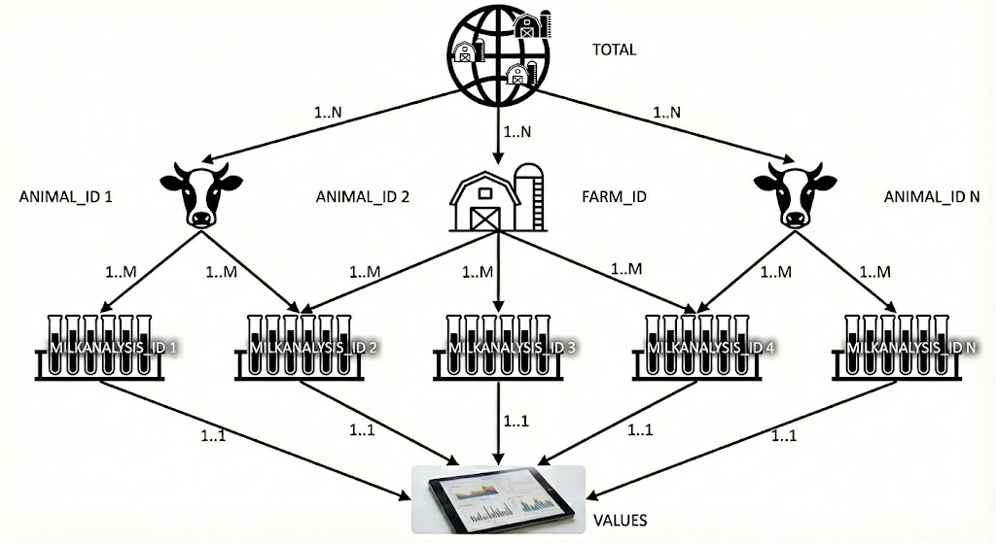

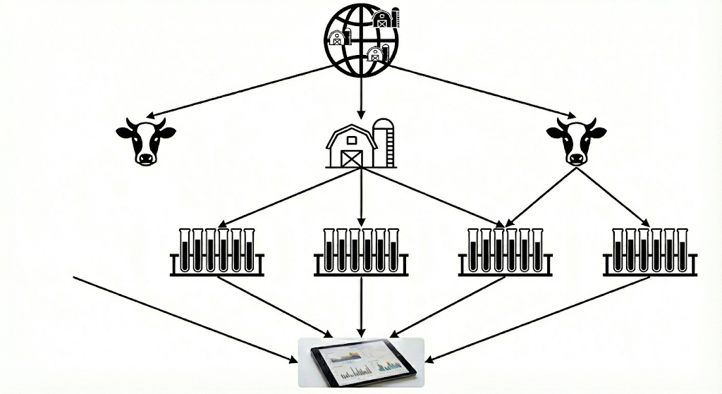
Level 0
TOTAL
Farm Level
Animal Level
Milk Level
Predictive Analytics of Climate Stress Impact on the Italian Mediterranean Buffalo

Slide 13
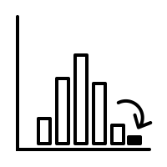

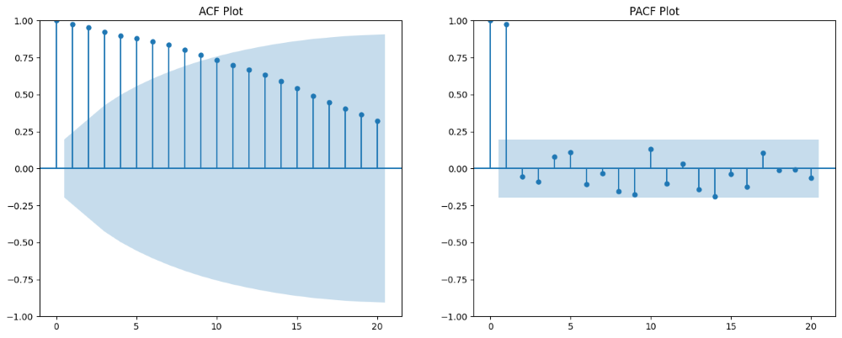
Preprocessing
Removing Outliers and null values
Time Series Decomposition. [8]
Statical methods like normal distribution.
Integrating climate data. [3,5]
THI Compose
Avg of 2 days before and after [3]
Lag Features
Captures the effect of past days
geeksforgeeks.org/machine-learning/what-is-lag-in-time-series-forecasting/
Predictive Analytics of Climate Stress Impact on the Italian Mediterranean Buffalo
Notes:
Ok preprocessing includes some steps, the first step is removing outliers and zero values because of desease or technical issues, I found a paper related to anomaly and outlier detection in cattles that I think it’s very helpful, so they used Time series decomposition and statical approaches like normal distribution for detecting outlier.
Time series decomposition breaks down time series data into components like trends, seasonality, and residuals,
The nest step is integrating climate data, some other studies didn’t use climate data or just utilized climate data from physical station near the farm while we are going to use nasa power API.
Another one is THI compose that Hassan in his paper in 2025 introduced and compared it to the actual THI and got better results,
And finally in all the time series forecastings Lag feature is an essential feature that capture previous effect on the actual values.

Slide 14
Model Selection for Prediction Task
Individual model for each animal [5,6]:
Not scalable.
Global model for all the animals.
LGBM, XGBoost, RNN works perfectly for global model. [3,7]
Predictive Analytics of Climate Stress Impact on the Italian Mediterranean Buffalo
Notes:
There are 2 related studies one in Korea and another in Australia in recent year used individual model for their prediction.
Also, there is another study that compared global and individual models for timeseries forecasting and the result was LGBM and RNN are out-performed the other models even compared with individual models.

Slide 15
Approaches of Implementation [9] : Top Down
Forecast
TOTAL
2/3
1/3
3/8
5/8
2/5
3/5
1/3
2/3
2/5
3/5
1/3
2/3
1/2
1/2
Predictive Analytics of Climate Stress Impact on the Italian Mediterranean Buffalo
Notes:
There are 2 related studies one in Korea and another in Australia in recent year used individual model for their prediction.
Also, there is another study that compared global and individual models for timeseries forecasting and the result was LGBM and RNN are out-performed the other models even compared with individual models.

Slide 16
Approaches of Implementation [9] : BU
TOTAL
+
+
+
Forecast
Predictive Analytics of Climate Stress Impact on the Italian Mediterranean Buffalo
Notes:
There are 2 related studies one in Korea and another in Australia in recent year used individual model for their prediction.
Also, there is another study that compared global and individual models for timeseries forecasting and the result was LGBM and RNN are out-performed the other models even compared with individual models.

Slide 17
Approaches of Implementation [10] : Optimal Solution
Forecast
TOTAL
Forecast
Forecast
Predictive Analytics of Climate Stress Impact on the Italian Mediterranean Buffalo
Notes:
There are 2 related studies one in Korea and another in Australia in recent year used individual model for their prediction.
Also, there is another study that compared global and individual models for timeseries forecasting and the result was LGBM and RNN are out-performed the other models even compared with individual models.

Slide 18
Hierarchical Reconciliation [10]
A model will be trained on the data[XGBoost, ...].
Forecast on the data using current model.
Reconcile the predicted values using statistical approaches:
MinT : minimize the variance between reconciled values and base forecast error.
Predictive Analytics of Climate Stress Impact on the Italian Mediterranean Buffalo

Slide 19
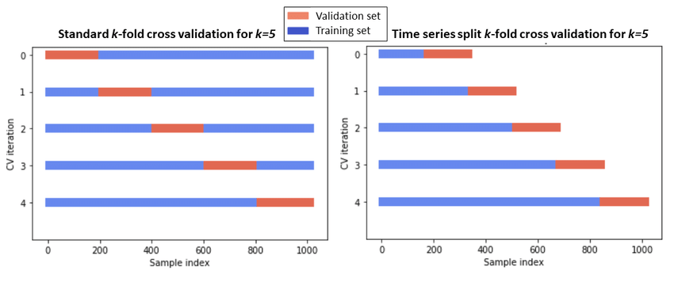
Evaluation and Metrics
Cross-Validation
Global model
We can use both
Individual model
We can use time series cross validation
https://www.researchgate.net/figure/Classical-k-fold-cross-validation-vs-time-series-split-cross-validation_fig1_355889701
Predictive Analytics of Climate Stress Impact on the Italian Mediterranean Buffalo
Notes:
To insure avoiding overfitting we should use a separate and unseen data for evaluate the model.
Cross validation is a way to evaluate our model and to do that we train and test the data for few times on different subset of data.

Slide 20
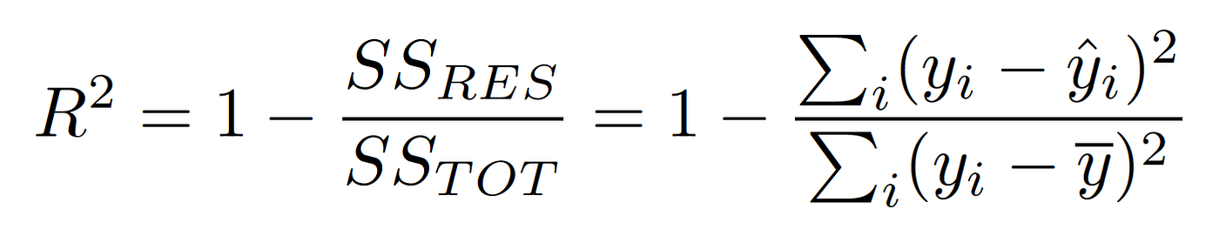
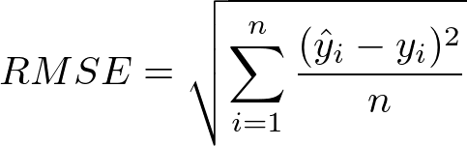
Evaluation and Metrics
R-squared
Root mean squared Error
Predicted Value
Actual Value
Mean of Actual Value
Number of samples
Predictive Analytics of Climate Stress Impact on the Italian Mediterranean Buffalo
Notes:
Here is two common metrics for evaluating performance of regression and forecasting models.

Slide 21
Potentials of this Project
Utilizing online Climate Data.
Buffalo-Specific prediction Model.
Computing Farm’s milk loss with HTS Structure.
Predictive Analytics of Climate Stress Impact on the Italian Mediterranean Buffalo
Notes:
Here is two common metrics for evaluating performance of regression and forecasting models.

Slide 22
References
[1] - Bernabucci, U.; Lacetera, N.; Baumgard, L.H.; Rhoads, R.P.; Ronchi, B.; Nardone, A. Metabolic and Hormonal Acclimation to Heat Stress in Domesticated Ruminants. Animal 2010, 4, 1167–1183. [Ref]
[2] - Dash, S.; Chakravarty, A.K.; Singh, A.; Upadhyay, A.; Singh, M.; Yousuf, S. Effect of Heat Stress on Reproductive Performances of Dairy Cattle and Buffaloes: A Review. Vet. World 2016, 9, 235–244. [Ref]
[3] - M.F. Hasan, N. Celik, Y. Williams, S.R.O. Williams, L.C. Marett,An effective way to incorporate temperature–humidity index to study effect of heat stress on milk yield by an XGBoost machine learning model,[Ref]
[4] - Hyndman, Rob J., and George Athanasopoulos. Forecasting: Principles and Practice. 3rd ed. Melbourne, Australia: OTexts, 2021. [Ref]
[5] - Boyu Ji, Thomas Banhazi, Clive J.C. Phillips, Chaoyuan Wang, Baoming Li, A machine learning framework to predict the next month's daily milk yield, milk composition and milking frequency for cows in a robotic dairy farm. [Ref]
[6] - Jae-Woo Song, Mingyung Lee, Hyunjin Cho, Dae-Hyun Lee, Seongwon Seo, Wang-Hee Lee, Development of individual models for predicting cow milk production for real-time monitoring, [Ref]
[7] - Hansika Hewamalage, Christoph Bergmeir, Kasun Bandara,Global models for time series forecasting: A Simulation study, [Ref]
[8] - Jae-Min Jung, Dong-Hyeon Kim, Hyunjin Cho, Mingyung Lee, Jinhui Jeong, Dae-Hyun Lee, Seongwon Seo, Wang-Hee Lee,Multi-algorithmic approach for detecting outliers in cattle intake data [Ref]
[9] – Rob J. Hyndman, Roman A. Ahmed, George Athanasopoulos, Han Lin Shang,Optimal combination forecasts for hierarchical time series [Ref]
[10] - Shanika L. Wickramasuriya,George Athanasopoulos,Rob J. HyndmanOptimal Forecast Reconciliation for Hierarchical and Grouped Time Series Through Trace Minimization [Ref]
Predictive Analytics of Climate Stress Impact on the Italian Mediterranean Buffalo

Slide 23
References
[11] - Omri, O., Kafa, N., Babai, M. Z., Jemai, Z. & Rostami-Tabar, B. (2025). On the inventory performance of hierarchical forecasting approaches: case of a vaccine supply chain. Journal of the Operational Research Society. [Ref]
[12] - Kim, M., Kim, H. & Moon, J. (2025). Beginner-Friendly Review of Research on R-Based Energy Forecasting: Insights from Text Mining. [Ref]
Predictive Analytics of Climate Stress Impact on the Italian Mediterranean Buffalo

Slide 24
Predictive Analytics of Climate Stress Impact on the Italian Mediterranean Buffalo
Presented by
Mohammad Sheikh
Supervisors
Dr. Luca Barbierato
Dr. Matteo Santinello
November 2025
Predictive Analytics of Climate Stress Impact on the Italian Mediterranean Buffalo

